Slide 1
The RED
PROJECT SPYN
G3 Hossain Tongye Even Dhruval

Slide 2
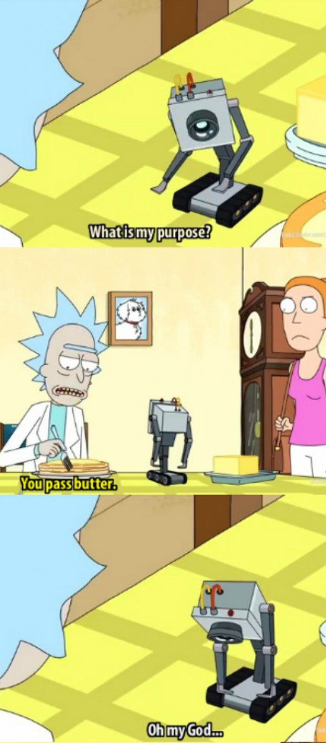


Project Spyn and our customer(s)
Autonomous car that keeps safety in mind
Ride-sharing concept
Main market: Senior citizens
Disabled and Wheelchair friendly
Targeting large retirement communities
Notes:
Perfect blend of safety and speed
Safety over speed
Why autonomous? Because machines are physical representations of a human's idea; humans make mistakes, machines don’t.
Autonomous, not sentient

Slide 3
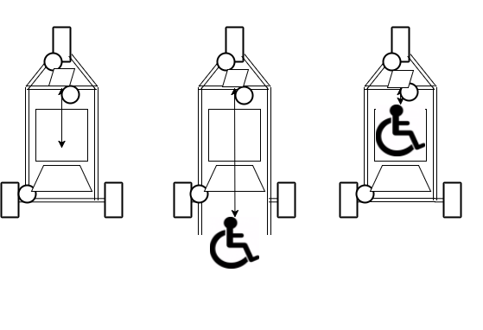
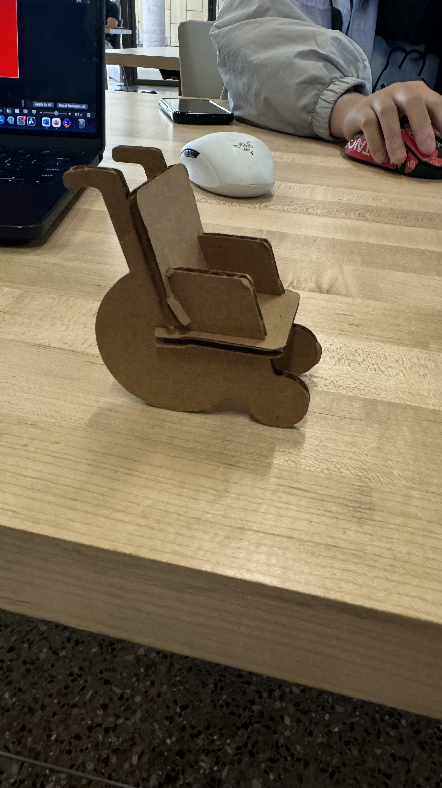
Initial Designs
2 Wheels
Forklift
300hp
Truck bed/ramp transport area
Autonomous chauffeur
Notes:
Final design based on the initial prototype
Everybody came up with different ideas, all the flaws were removed, and the final design was a mixture of everyone's ideas.

Slide 4
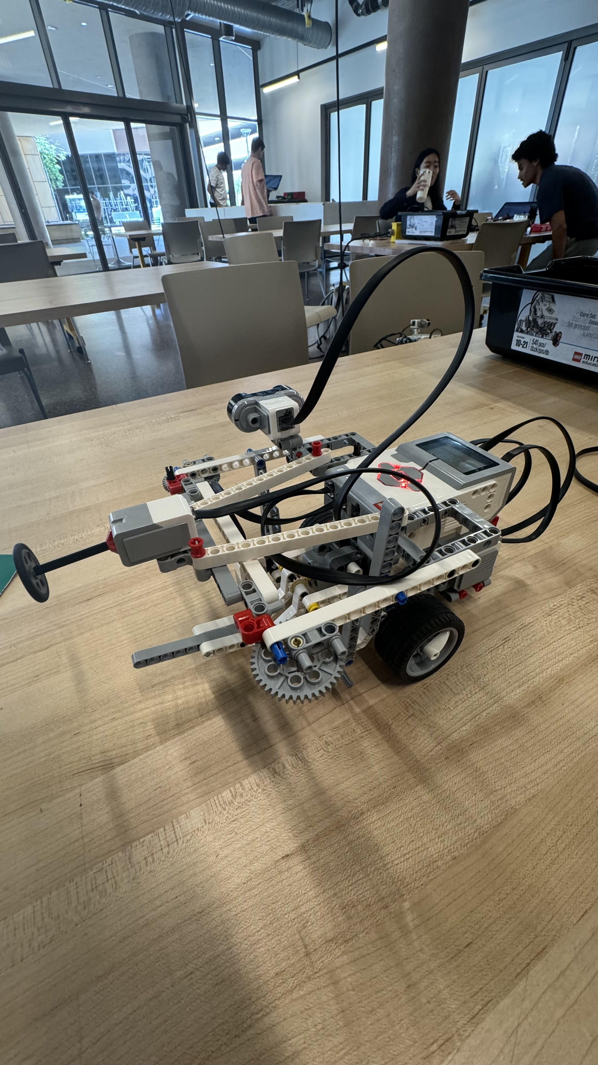
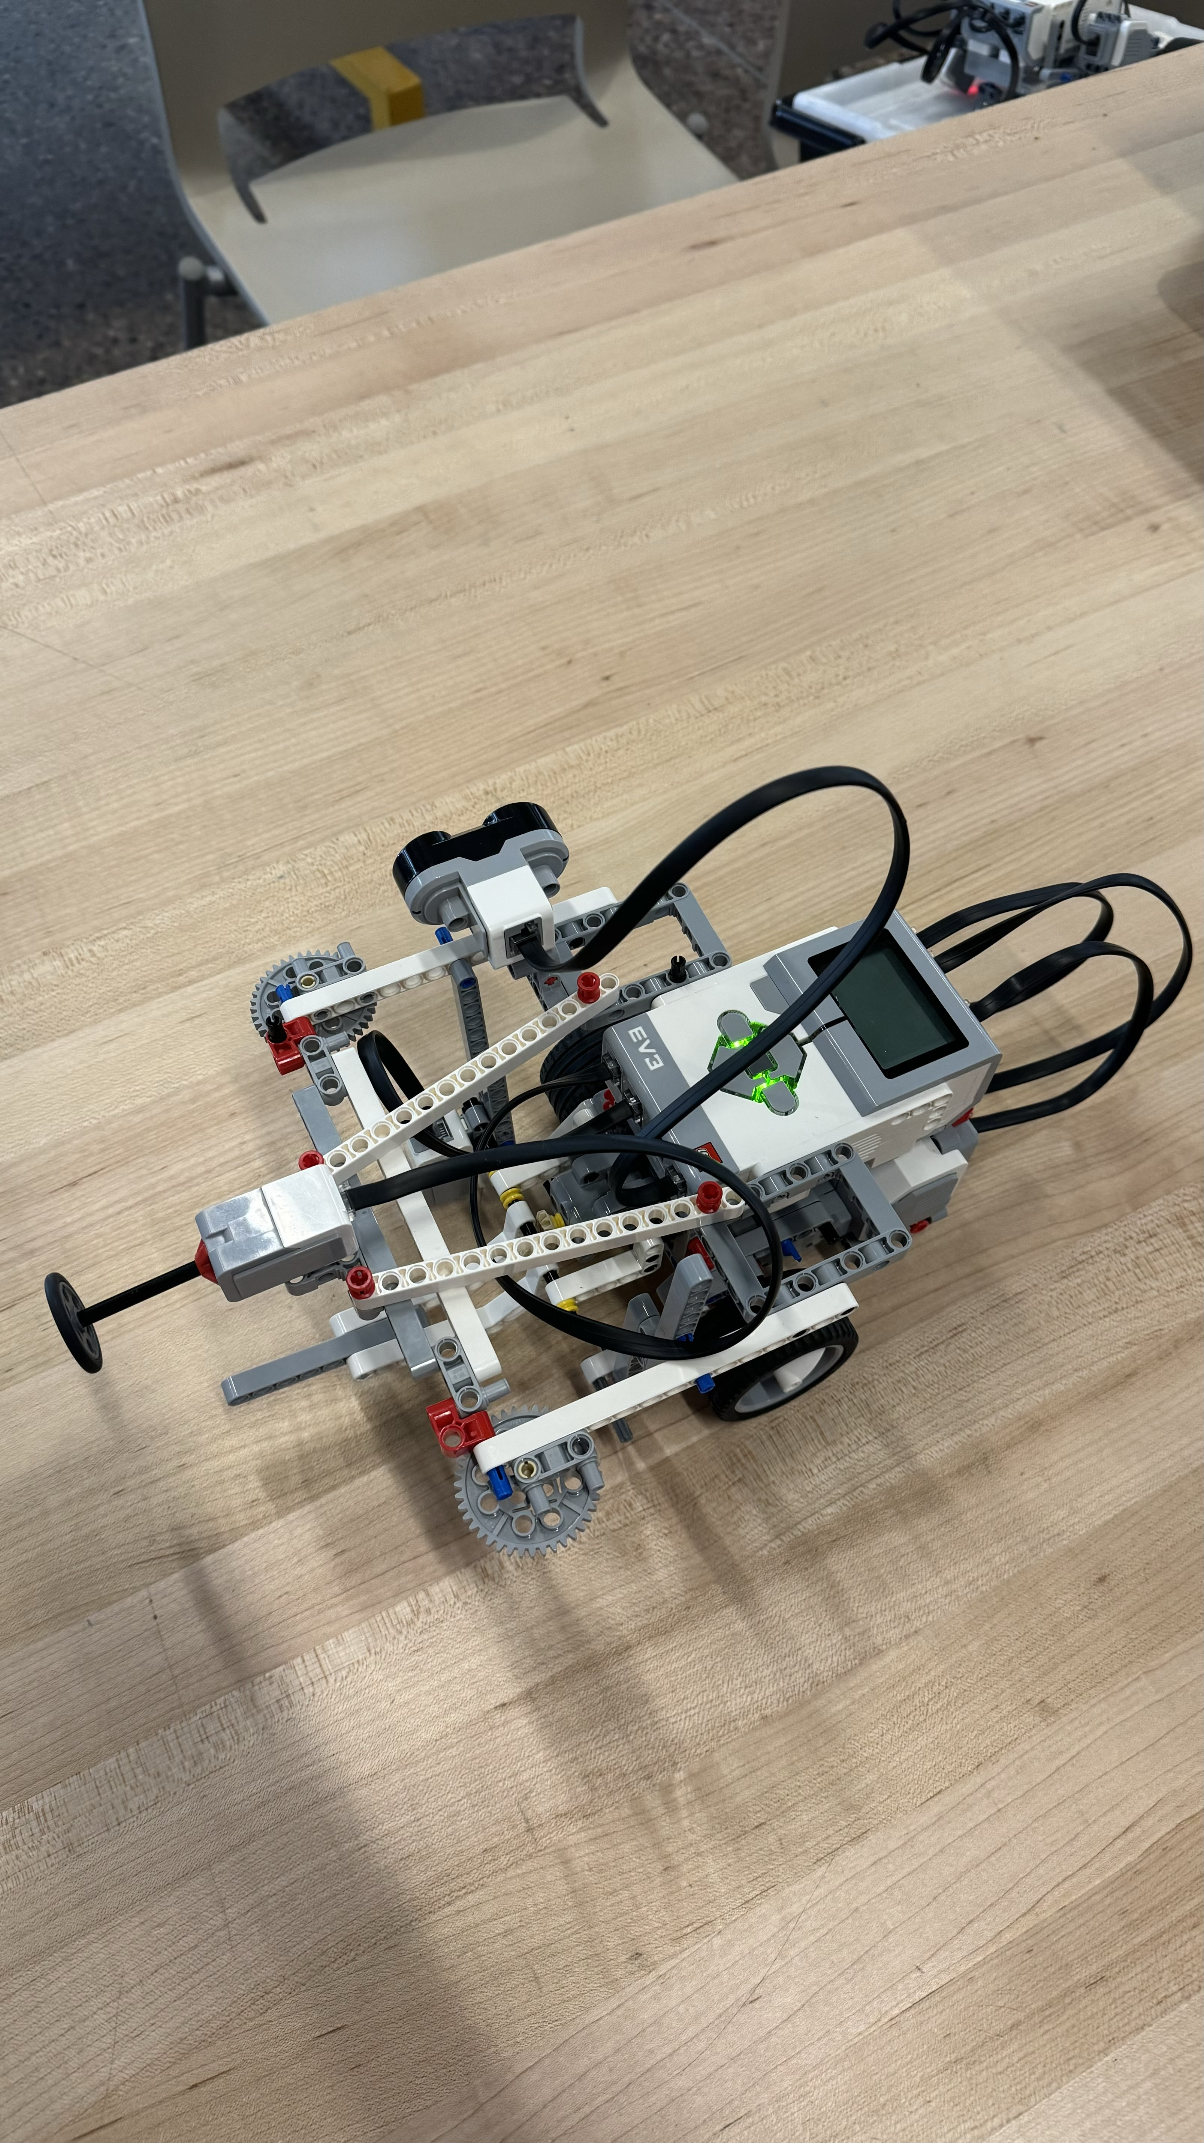
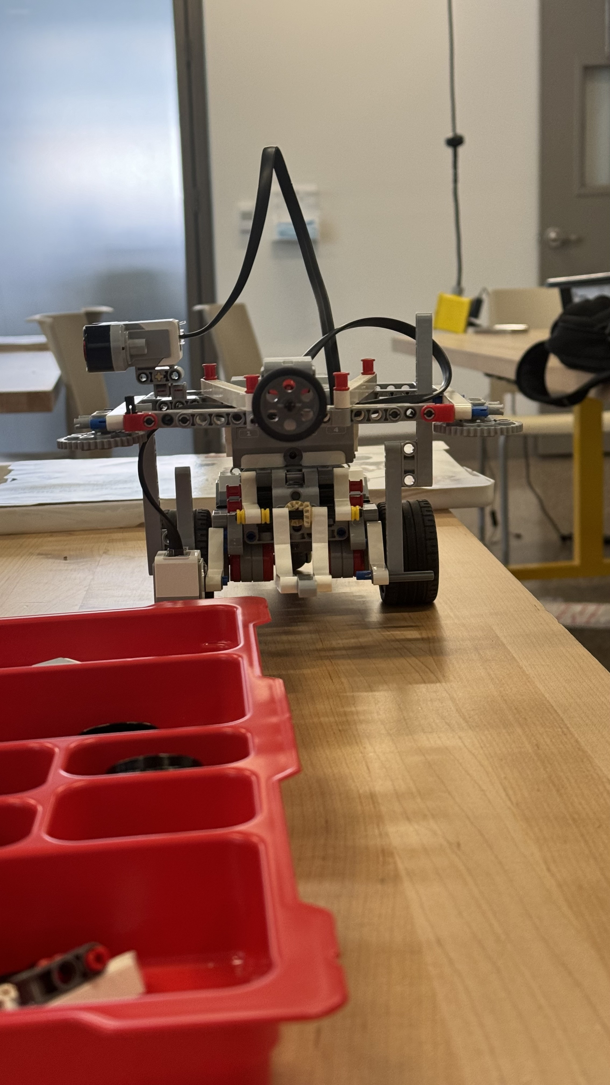
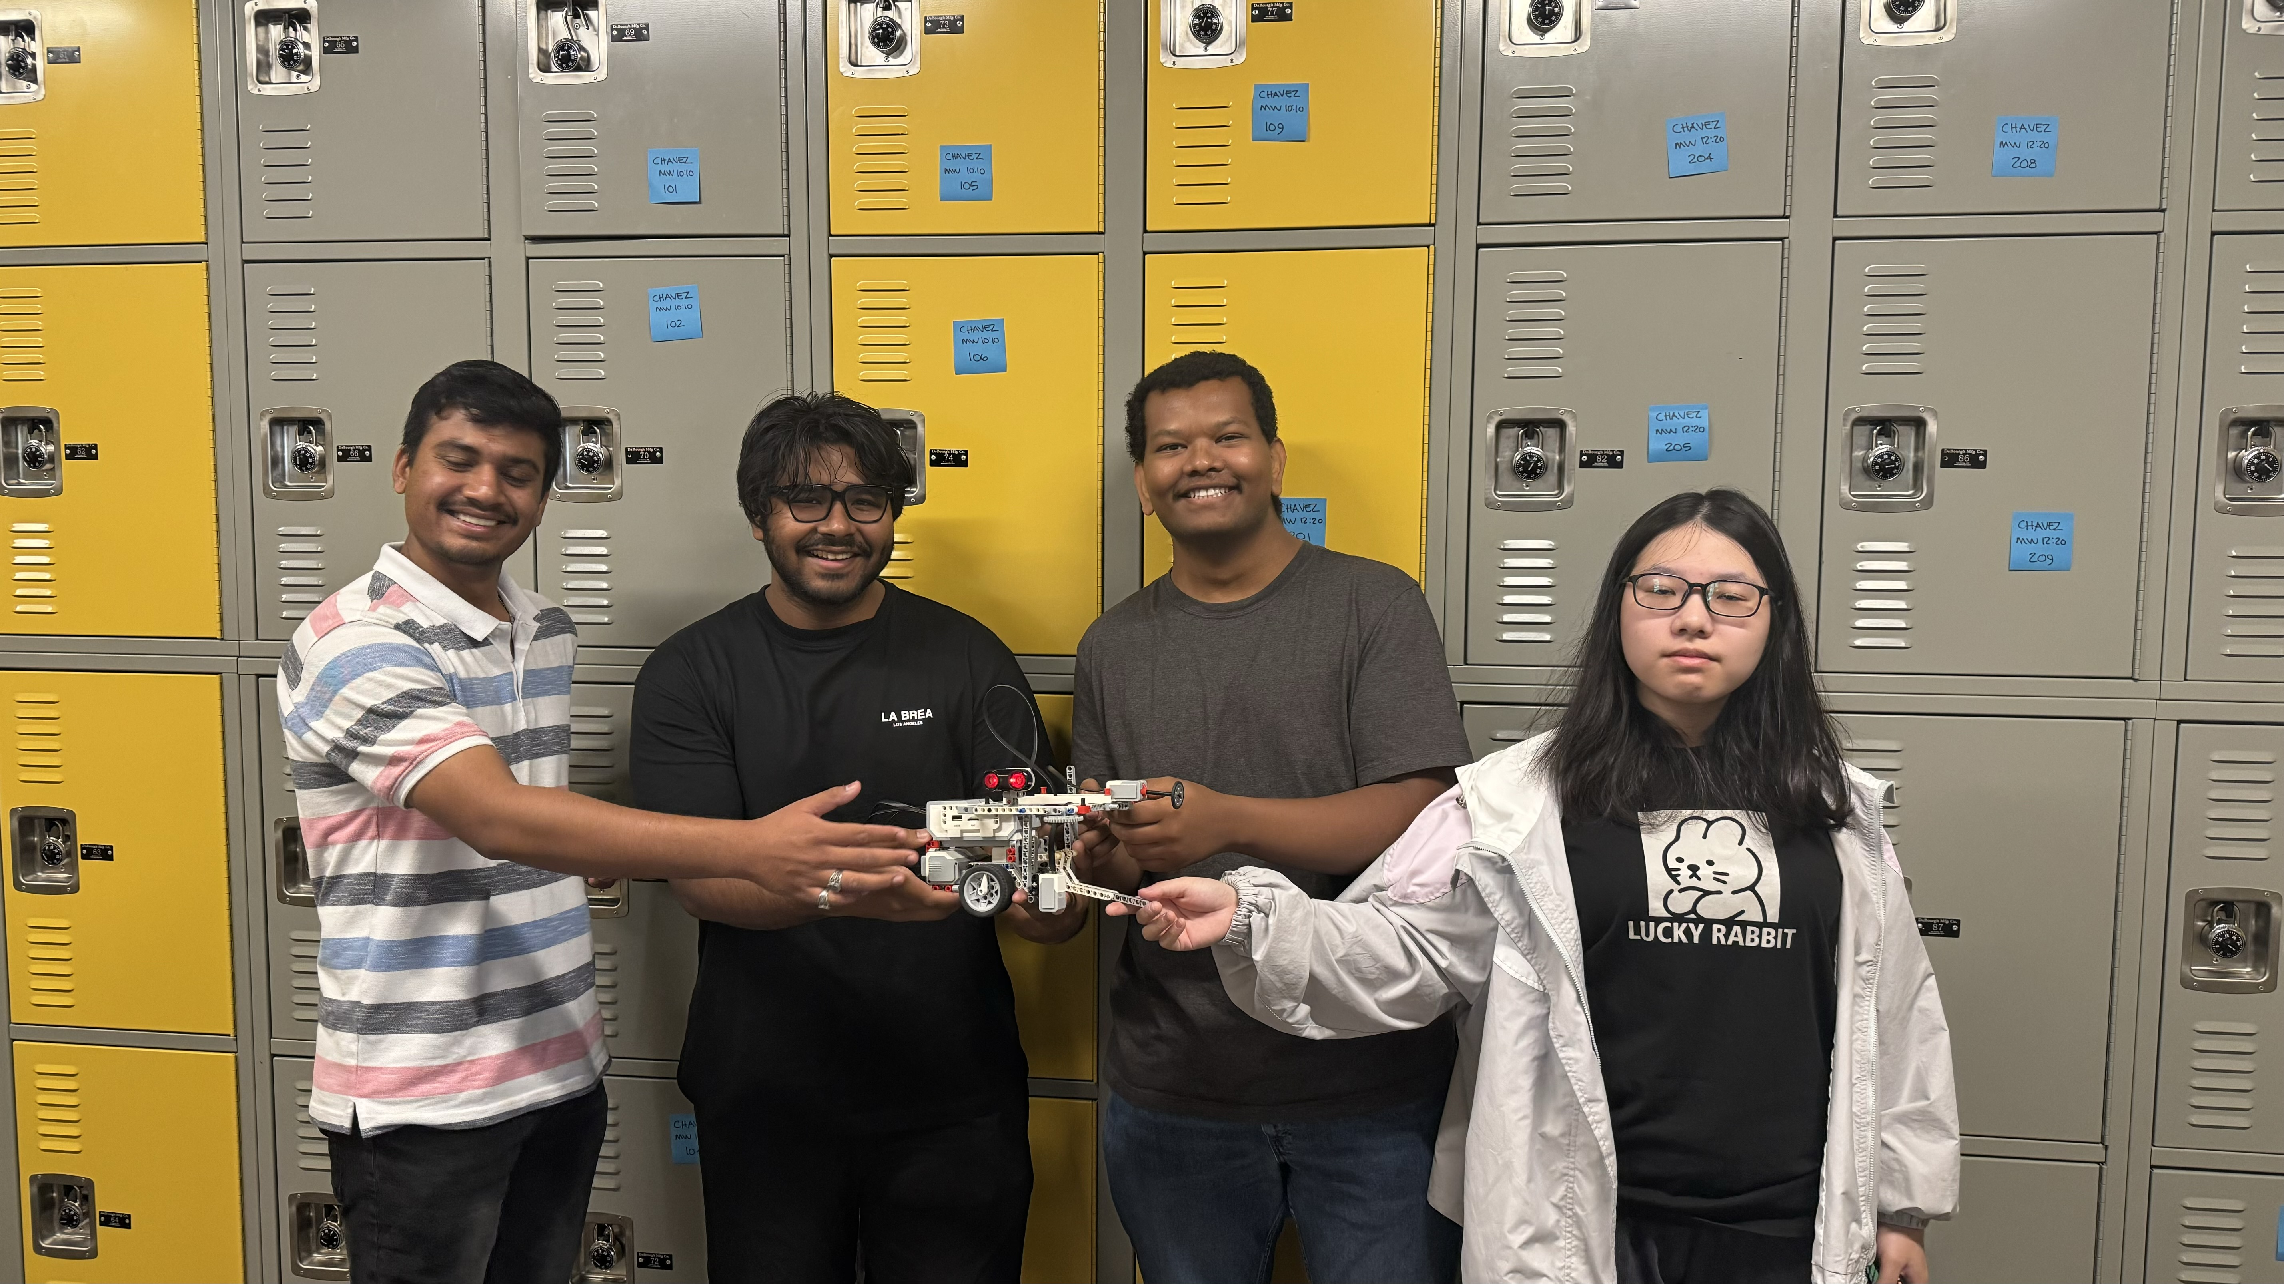
The Project Red
®️
Notes:
Speak about “why two wheels”
Mention the revisions to the claw, vehicle specifications

Slide 5




Passenger Transportation
The vehicle is designed to carry one passenger, who is seated in the posterior portion of the vehicle
The vehicle switches to remote control when the pick-up zone is encountered
It makes a 180˚ turn, approaches the passenger and secures him/her with the seatbelt, claws, and gate-claws.
The vehicle switches to autonomous mode, and navigates to the dropoff point, acknowledging stop-points en route
The vehicle switches to remote control when the drop-off zone is encountered. It makes a 180˚ turn. The claws, seatbelt unlock and the passenger is dropped off as the vehicle backs up.
Notes:
Car structurally sound to absorb impact without throwing about the passenger, also most of the impacts are happening in the anterior portion and the passenger won’t feel any of them
180˚ turn, quick and simple
Acknowledges all stop points en route by halting momentarily and subsequently resuming motion
Remote control via a bluetooth controlled device

Slide 6
Future Plans
Fully autonomous navigation, pick-up, and drop-off
Scanning the maze and logging turns, speed modifications, stop, pick-up, drop-off points
Increasing seating capacity to accommodate a companion, service animal

